Slide 1
Programming Skills
Including use of Python

Slide 2
Learning Objectives
To be able to write a simple program
To understand basic terminology for programming
To understand how to use IDLE interactive shell and FILE EDITOR
To know and use arithmetic operators in a programming language
Understand the concept of a data type
To understand and use different data types

Slide 3
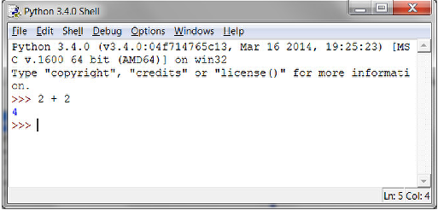
Some Simple Maths
When you open IDLE (do that now) you can use it as a basic calculator
Computers use the following operator symbols
+ Addition
- Subtraction
* Multiplication
/ Division

Slide 4
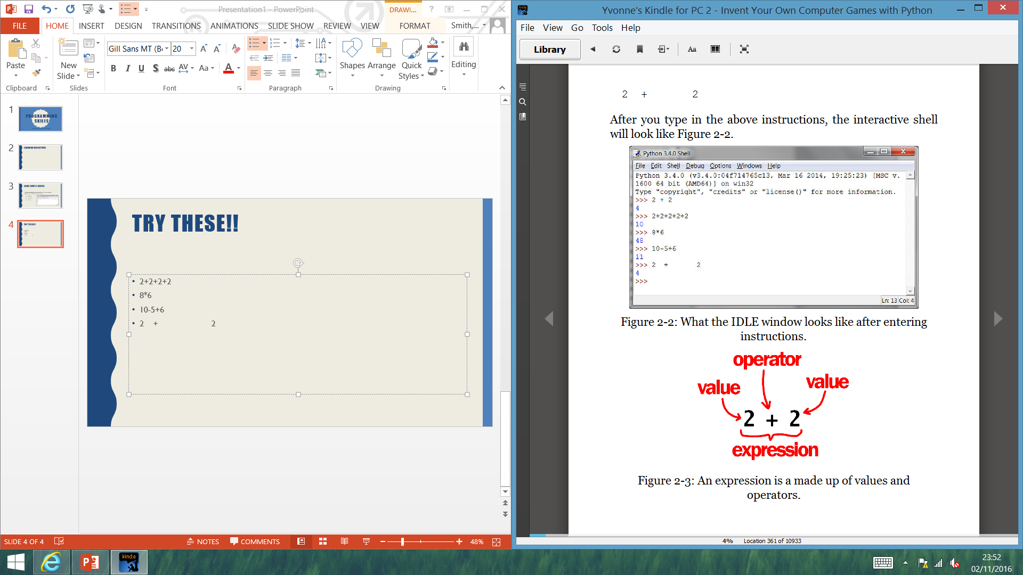
Try These!!
2+2+2+2
8*6
10-5+6
2 + 2

Slide 5
Integer and Floating Point Numbers
Integers (ints for short) are whole numbers, examples 4; 99; 0; 34056
Floating point numbers (floats) are fractions or numbers with decimal points, examples 3.5, 42.15; 5.0
In Python 5 is an Integer but 5.0 is a float.
All are known as VALUES
Maths problems are called EXPRESSIONS
Computers will also follow the ‘rules’ of maths i.e. * and / before + and -

Slide 6
Syntax errors
If you type 5+ at the prompt and press enter before finishing the expression the computer will respond with a SYNTAX error
It basically means the computer didn’t understand the instruction because you typed it incorrectly.
This will likely happen to you a lot. Don’t worry about this; just re-type the instruction correctly at the next >>> prompt

Slide 7
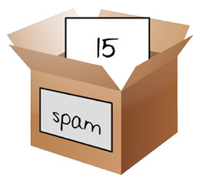
Variables
Hoping you noticed this!
Variables can hold words as well as numerical values. These words are still called VALUES but are known as STRINGS
Some of the variables are not named very well
Points to note!
Spam = 3 [Will OVERWRITE the current contents of Spam]
Spam = Spam + 5 [Will add 5 to whatever is in Spam; so if Spam holds the value 15 it will add 5 and store the new value of 20 into the variable Spam]
Values can be stored in VARIABLES
Think of a variable as the name of a box you put your value into. Example SPAM = 7 + 8
TASK:
Check out the ‘Variables’ around the room. What can you deduce about them?

Slide 8
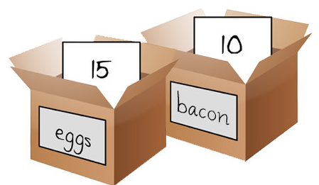
Using more than one variable
>>> bacon = 10
>>> eggs = 15
>>> sandwich = bacon + eggs
>>> sandwich
What should happen here?
Try it!!
If two rashers of bacon and one egg are used to make the sandwich, how would you write a program to work this out if bacon = 16 and egg = 8?
What happens if you have variable values of bacon = 10 and egg = 8?
Does you first program work with different variables?
You can create as many variables as you need in your programs and use them in calculations
It’s a good idea to give your variables names that are relevant to the contents stored in them.

Slide 9
Theory Books
Write a definition for
Integers and floating Point numbers
Expressions
Values
Operators
Variables
Syntax Error

